Slide 1
Moscow and Voronezh: compared
IBM capstone project

Slide 2
Introduction
I’m not sure if it is exactly a business problem, but I want to compare my hometown – Voronezh with my new city – Moscow. Voronezh is quite developed city with more than one million population. Obviously, life there is less expensive than in capital city. But this project gave me interesting idea – let’s compare these two places only from venue point if view. Maybe in this particular case there is no such terrific difference. Or maybe all neighborhoods of Voronezh closer to only suburban areas of Moscow, who knows?

Slide 3
Data description
I used:
Geopandas geocoder to gain coordinates of cities neighborhoods
Foursquare API to collect information about venues in Moscow and Voronezh
As preprocessing step I generalized some venue categories (For example – all sorts of restaurants in one category)

Slide 4
Methodology
Collect and analyze data
Preprocess data
Use K means to perform clustering
Visualize results by means of folium

Slide 5
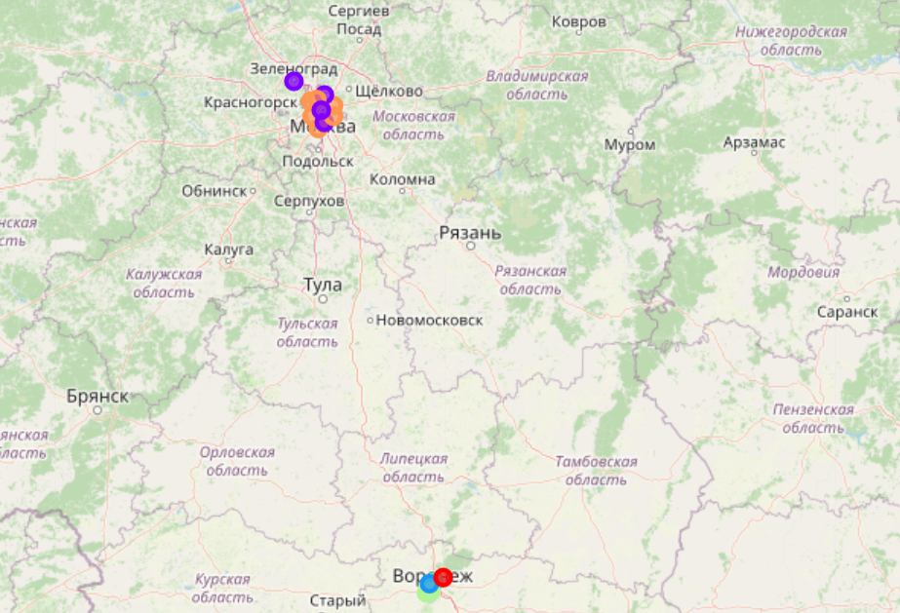
Results and discussion
There is no common clusters in Moscow and Voronezh.
By using K Means I understood that these two cities are too different to generalize even only in venues field.

